Slide 1
Explain
ROS nodes, topics and messages.
ROS services and actions.

Slide 2
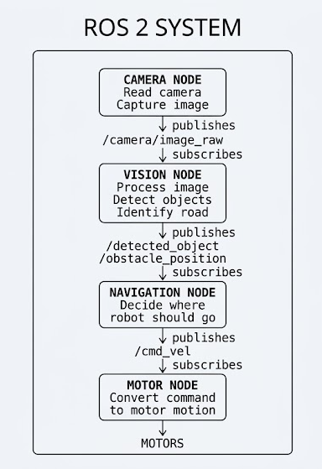
ROS nodes, topics and message

Slide 3
ROS services.
Topic
Think of a lift continuously sending its current floor information:
Lift ─────► "Floor 1" ─────► Display
Lift ─────► "Floor 2" ─────► Display
Lift ─────► "Floor 3" ─────► Display
Lift ─────► "Floor 4" ─────► Display
Data keeps coming continuously.
Topic = continuous communication
Service
Now think about pressing a lift button:
Person ── "Go to Floor 5" ──► Lift
Person ◄──── "Accepted" ───── Lift
The person makes a request, and the lift gives a response.
Service = Request + Response
Easy real-life example
Think about a lift/elevator.
We press:
Floor 5
The elevator receives your request and eventually responds by taking you there.

Slide 4
What is a ROS 2 topic? Explain how data is transmitted through a topic.
What are ROS 2 messages? Explain the purpose of standard message types such as Float32, Float32MultiArray.
What are ROS 2 services? How are they different from topics?
What are ROS 2 actions? Explain where actions are useful in robotics applications.
Differentiate between Topics, Services, and Actions in ROS 2.

